Slide 1
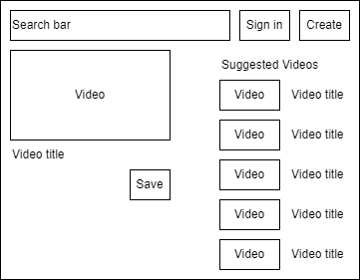
YouTube Video Player
Use case 1: Play a video
Video player page

Slide 2
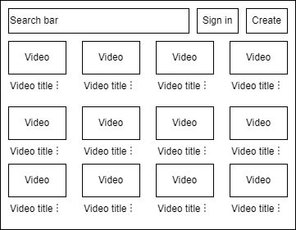
YouTube Video Player
Use case 2: Suggest a new video
Home page

Slide 3
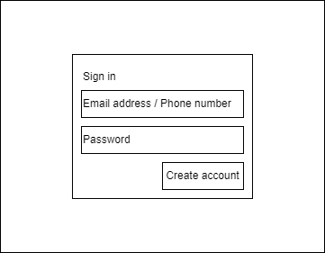
YouTube Video Player
Use case 3: Sign in
Sign in page

Slide 4
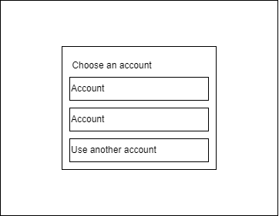
YouTube Video Player
Use case 3: Sign in
Sign in page when the user has already signed in and signed out before

Slide 5
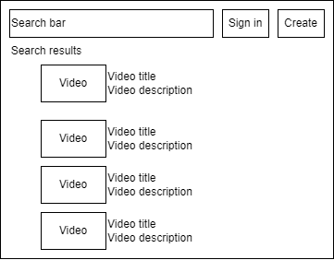
YouTube Video Player
Use case 4: Search for a video
Search results page

Slide 6
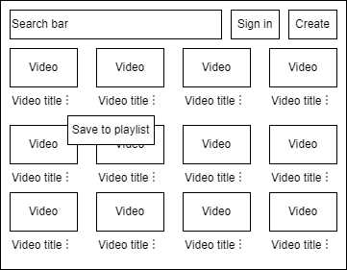
YouTube Video Player
Use case 5: Make a playlist
Home page when the user clicks on the ⋮ (three vertical dots) to the right of the video title

Slide 7
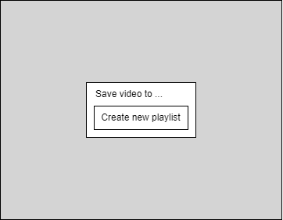
YouTube Video Player
Use case 5: Make a playlist
Create new playlist button

Slide 8
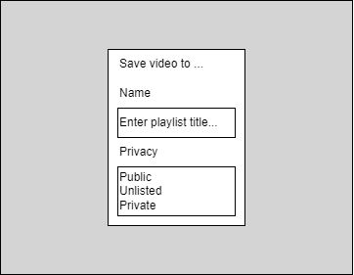
YouTube Video Player
Use case 5: Make a playlist
Create new playlist modal

Slide 9
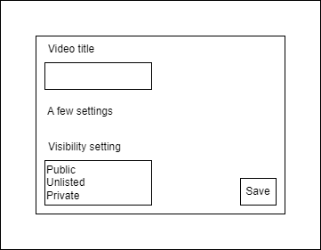
YouTube Video Player
Use case 6: Upload a video
Upload modal in upload page

